Slide 1
Agenda
1. Current Situation
2. Problem Identification
3. Problem definition and Strategy
4. Detailed process for ‘touchless’ experience
5. Potential problems – Risks
6. Financial Analysis
7. Requirement's prioritization
8. Conclusions
9. Recommendations

Slide 2
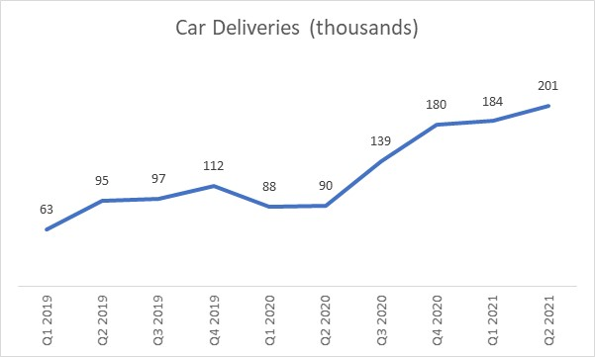
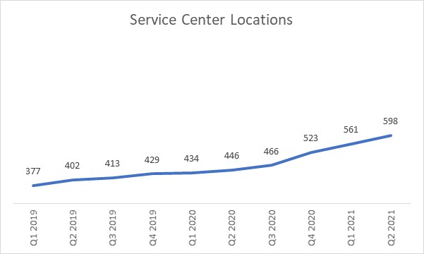
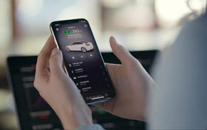
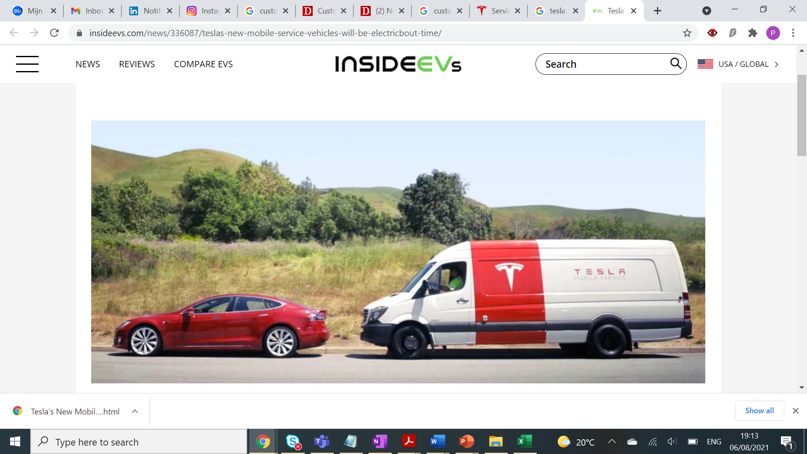
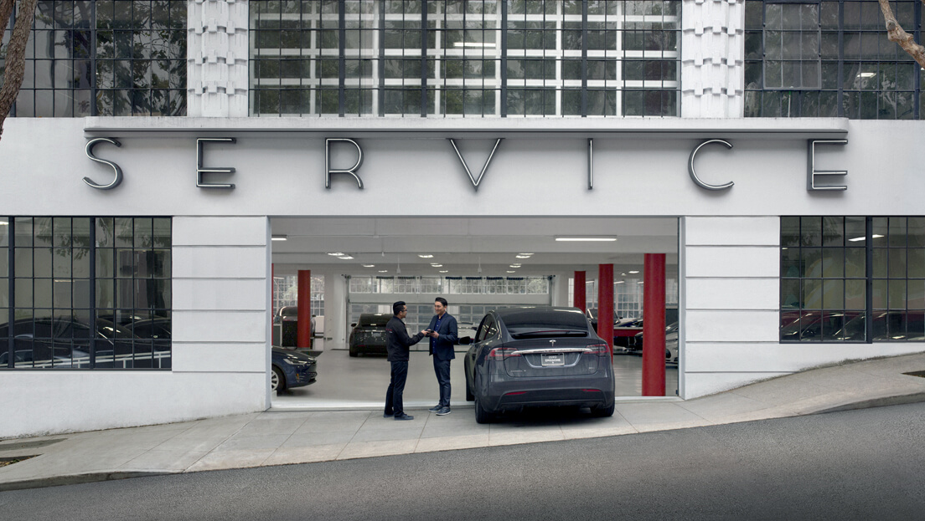
1. Current Situation
Car company Cars deliveries (Sales) had been increasing steadily in the last years. In Q2 2021 there’s been a peak of 201K sales..
..The Amount of service center, nevertheless, has no increase in the same pace
In order to get in pace with the peaks in sales, Car company Service team has made huge efforts during the last years:
Mobile APP service appointments
Mobile Service ‘Car company Rangers’
More Service Center

Slide 3



2. Problem Identification
To identify the problem/ main problems from our customers in the service center / rapair process, is important to understand the customer Journey and identify pain points in each phase.
Mobile APP Appointment
Prepare visit
Service Center Visit
Pickup Car
Activity
Client select type of service | Client fill comments and photos. | Client select service center. | Client selects a time for its appointment | Client confirms its appointment.
Car company Mobile APP | Car company Mobile APP | Car company Mobile APP | Car company Mobile APP | Car company Mobile APP
Client might not find the category / might feel overwhelmed | Client might feel long process or unnecessary step | Client can’t find service center near its work/house. | Client can’t find a suitable timeslot
 | Explain importance of this step: this is the single point of contact with technician. Improve UI: progress bar? | Increase the service locations. | Increase the service locations. Increase the timeslots (24X7 possible?)
No Critical | Medium Critical | Critical | Critical | No Critical
Client Approve cost estimate | Client drives to appointment
Car company Mobile APP | Car company Mobile APP
Client find excessive cost. client wants more details | Client takes too long to arrive. Feeling: there’s nothing to see around here.
Send by email details of the estimate. Explore the need of this step in this stage (experiment?) | Service Center closer to the city. Car company could inform what other activities there’s around (malls, museum)
No Critical | Critical
Client arrives service / Check in | Client waits in Service center | Client leaves service center w/leased car
Advisor APP | company Center / waiting room | Car company leased car / taxi
Client doesn’t know where to go. | Client doesn’t knows how much needs to wait, or feels uncomfortable. | Client doesn’t like its loan car
Get guidelines in the car (touchscreen) where to go. | Client access a ‘Car company Service VIP card’: allows him/her to go to the nearby restaurants, meanwhile waits for its car. | Client could choose other means of transport: NS Card / Bike
No Critical | Critical | Medium critical
Client has to commute to Service Center | Client receive its car
Taxi Public transport | Car company car
client needs to spent money or time for long journey to service center.
A service center closer to the client would be optimal solution. Meanwhile a transportation subsidy by Car company. | Message in car’s screen: thank you for using our service.
No Critical | No Critical
Touch Point
Emotions
Pain Points
Opportunities
Critical Proces
From the CJM the critical painpoints are related to:
Importance to let the details of the repair clearly in the APP
There’s not enough service centers available

Slide 4
3. Problem definition and Strategy
Previous research has helped to understand and define the problem to tackle:
How might Car company
Enhance the customers experience in the service centers,
Keep its employees motivated, and
Be more costly efficient at the same time?
Solution - Car company ‘Tech only Service Center’
1. Inexpensive implementation
Tech only Service center will not have customer representatives in store, but they will work remotely
Tech only service center will be smaller than the big regular centers, its capacity will be around 50% of the large ones, with no ‘client’s waiting room’
For the same reason, the space rental will be considerably lower
2. Near to the customer
Tech only service center should be located in the city.
Amsterdam example: Oud-zuid, Park de meer, oud-west
Tech only service center should be located not far from attractions such as malls, restaurants, etc.
Tech only service center in city generates a virtuous circle
‘Tech Only Service Center’ Strategy Pillars
3. Great Customer Experience
Tech service appointments should be through the APP
Details where to park, pickup car, return loan car should be in the APP / screen
Car company Advisors will be phone available during whole process
Status of the service in the mobile APP should be frequent and accurate
4. Maintain employees’ satisfaction
“In house” advisors will be supporting clients from a remote location (or home)
Advisors will have the opportunity to develop in the company:
Collaborate with the “Car company mobile rangers” team
Collaborate with the CX team as “voice of the customer”.

Slide 5
4. Detailed process for ‘touchless’ experience
Based in previous pillars, the ‘touchless’ process should be the following:
Mobile APP Appointment
In Service Center
Technical review
Pickup car
Before Arrival
Client selects: schedule service, select type of service, and type notes & photos
Client place its address and the option of ‘Tech only service appears’
Client selects ‘Tech only service’ and timeslots are shown
After timeslot is chosen, client is asked to confirm the notes and photos: ‘Client needs to be specific in this part since there’s no advisor in this service’
Client receives message: exact parking space will be share one day (hour) before your appointment
Client confirms appointment.
Before its scheduled service (day before or hours before), client receive call from Car company advisor (email or message if client don’t answer call), to emphasize that the client just need to leave its car in the parking garage
Advisor will inform client that if any doubt in the service center, client can call the advisor back, but advisor wont be in center
Before its scheduled service, Client will receive a message in the app where exactly should park and leave its car in the center. (including guides, photos and detailed instructions)
Same message should be displayed in the car touchscreen
Client enter service center and parks in specific space
After parking, client checks-in through the app
Validation occurs between car and parking space. If correct client will receive a ‘Car company Free-pass virtual card’ with free tickets for shops nearby the service center. This free tickets will have a specific timeframe (hours only). This card will replace the ‘waiting room’ that big service centers provide
Client receives message that technician will take 30 minutes to asses the repairing time, and will inform immediately
Client leave service center, meanwhile the technician inspect the car
Technician will have 30 minutes to assess if repair can be done ‘in the air’, or car needs to stay
Technician will update on its system status of repair:
Can be done in x hours
Car needs to stay overnight
If car needs to stay, and there’s loan car available, client receives instruction from which parking space pickup loan car
If there’s no loan car, or client refuse loan car, a transportation ticket will be sent to its email
Client will receive a estimated time to pickup car
If client needs any support, can call the Car company advisor
Client will track status of its service trough the APP
Once car is ready to pickup, client will receive the specific parking space where to pick its car, and where to leave the loan car (if applicable)
Client should pay the cost of its service through the app.
Client will leave the loan car in parking space, and pickup his/her car
In case anything is missed, client can call its service advisor
Key Factors
Client details about the problem
Client understand the difference with its previous visits.
Client values the virtual card same as waiting room
Technician can assess in 30 mins the repairing time
repair time is no longer than average
Process should run smoothly.

Slide 6
5. Potential problems - Risks
Previous ‘key factors’ for success are also risks in the implementation. This action plan could be considered in case the problems persist.
Problem | Action plan
Client don’t leave details of the service in the mobile APP (no photos, no comments) | One more step should be added in the service appointment process: after selecting ‘tech only service’ client should confirm its comments, or for some specific services a photo is compulsory. otherwise wont be possible to continue.
Client leaves its car in different parking space that the one specified | Parking spaces should have a sensor/mechanism to identify the car is correctly positioned. If is not correct a message will be sent to the client to move the car. If after some time client don’t move the car a call from the advisor will be required.
Client is annoyed that there’s no waiting room in tech only service center | After service survey will include a specific question about the replacement of the waiting room with the ‘Car company free-pass Card’. In case negative feedback client will be remember to choose other service in next appointment (message in the app).
Technician takes more than 30 minutes to assess repairing time | In case there’s no update from technician after 40 minutes, an automatic message will be sent to client informing that repair wont be ‘in the air’ and might take more than 4 hours, and client can pickup loan car (if applicable). If happens frequently: adjust SLA
Repair time takes longer than average | In order to don’t create a ‘bad reputation’ to the Tech only Service Centers, some services/repairs that usually are ‘complicated’ and uncertain in the repairing time shouldn’t be considered for this channel. This will require an extensive analysis to don’t give the perception of ‘limited services’ to the Tech only Service centers.

Slide 7
6. Financial Analysis
From the financial point of view, we need to consider that the tech service center is a side project to the main Car company business: Cars Sales
Therefore, the ROI on this project will not be as large as another Car company Business
Revenues for 1 Service Center
= (Average ticket for a car visiting the service) X (Amount of cars visiting the tech service center)
Average ticket = € 334.6/year
Number of Services = 2,304/year (10% increase every year)
Revenue in 10 years = € 13,316,384
Costs for 1 Service Center
Rental expense for tech service center = € 450,000/year
Leased equipment = € 24,000/year
Payroll = € 3,480,000/10 years
Reparation cost = € 50/car
Costs in 10 years = € 8,917,458
€ 4,4m in 10 years
ROI = 49%
Please forward to ‘Appendix’ for details on this calculation

Slide 8
7. Requirement's prioritization
How to prioritize all the requirements?
There are several teams involved in this project:
Real state team: To find a proper space.
Branch implementation team: To lease equipment and make the service center up and running.
CX Mobile Team: to make adjustments in the APP
Car company Advisors team: To train in its new function for remote service.
Technicians team: To train them in the updates in the app for the new Journey
… and probably others that I’m missing.
In a high level overview, the process should follow:
Branch Implementation
Systems –Mobile Adaptation
Training – People adaptation
Enter into more details and assumptions would take much more time to develop. To come with a proper prioritization, I’d use scrum-agile (for example to have an MVP in the Mobile app changes).

Slide 9
8. Conclusions
Due to the exponential sales in Car company Cars, the number of service centers need to increase quickly.
My case has focused in opening new service centers, more than replacing the current ones.
Car company shouldn’t focus in big service centers, but in many small ones inside the city, this will also generate branding and create a virtuous circle increasing more sales.
Car company client is already experiencing ‘Touchless’ service experiences with the ‘Car company rangers’, so the transition shouldn’t be a problem.
Competition is fierce in the EV sector in Europe, and Car company can’t expose to bad advertising. Employees in the service centers should evolve and Car company should use its expertise in many other departments.
9. Recommendations
Open new ‘tech only’ service centers, clients will have a smooth transition.
The main point of contact for scheduling appointments is the mobile app, Car company should enhance the capabilities in the software development team to have the app always up and running.
Marketing team should increase communication about the importance of being specific in the appointments (take photos, comments, etc), this will help the technicians and the client to repair faster.
Car company should use the service advisors as part of their CX team, to understand better their customers.

Slide 10
Appendix

Slide 11
Revenues
Costs
Repair Service | Cost | Average | Prob event | Cost
Brake caliper replacement | $357 - $593 | 475 | 0.1 | 47.5
Oxygen sensor replacement | $271 - $444 | 357.5 | 0.1 | 35.75
Window motor regulator replacement | $592 - $851 | 721.5 | 0.15 | 108.225
Wheel bearings replacement | $325 - $394 | 359.5 | 0.2 | 71.9
Repair cost in 5 years |  |  |  | 263.375
Repair cost per year |  |  |  | 52.675
Year | Technicians | Admins | Manager
1 | 180,000 | 36,000 | 72,000
2 | 180,000 | 36,000 | 72,000
3 | 180,000 | 36,000 | 72,000
4 | 240,000 | 36,000 | 72,000
5 | 240,000 | 36,000 | 72,000
6 | 240,000 | 36,000 | 72,000
7 | 240,000 | 36,000 | 72,000
8 | 300,000 | 36,000 | 72,000
9 | 300,000 | 36,000 | 72,000
10 | 300,000 | 36,000 | 72,000
Total | 3,480,000
Payrolls
Manager: 1 for 72K per year
Admin: 1 per 36K per year
Technicians: 3 in first 3 years. 4 in 4 next years, 5 in last 3 years. Each of them with 60k per year
Year | Maintenance Service | Cost
1 | Tire rotation | 100
2 | Full service with A/C | 525
3 | Tire rotation | 100
4 | Full service with brake flush | 585
5 | Tire rotation | 100
 | Total maintenance 5 years | 1,410
 | Maintenance cost per year | 282
 | Total (Maintenance + Repair) | 334.675
This calculation just for the Average Ticket
Source for maintenance costs: https://www.motor1.com/reviews/406938/Car company-maintenance-cost/
Reparation
Reparation cost is a % of the average maintenance ticket: 15%
0.15 x 334 = 50
Rental
Rented Space is 80 x 80 m2
Cost per m2 per year is 50 EUR
Total rental cost per year = 80 x 80 x 50 = 320,000
Total Cost 10 years:
Rental: 320,000 x 10
Leased Equipment = 24,000 X 10
Reparation Cost = 0.15x 334.575 x 39,789
Payroll = 3,480,000
Total costs 10 years = 8,917,458
Year | Amount of Services | Revenue
1 | 2,496 | 835,349
2 | 2,746 | 919,018
3 | 3,021 | 1,011,053
4 | 3,323 | 1,112,125
5 | 3,655 | 1,223,237
6 | 4,021 | 1,345,728
7 | 4,423 | 1,480,268
8 | 4,865 | 1,628,194
9 | 5,352 | 1,791,181
10 | 5,887 | 1,970,232
Total Revenues 10 years |  | 13,316,384
Amount of services =
8 services per day x 25 days per month x 12 months.
Amount of services increase in 10%.every year.
Revenues = Amount of services x 334.6 EUR (average Ticket).

